Slide 1


Massachusetts General Hospital Performance Analysis
(DEPI – Power BI Track 2025)

Slide 2

Introduction & Project Scope
Project's goal:
To analyze the operational and financial performance of Massachusetts General Hospital using an interactive Power BI dashboard. The analysis focuses on identifying patterns in admissions, encounters, procedures, and revenue to evaluate hospital efficiency and patient care outcomes. The findings highlight areas of excellence and improvement for academic and administrative review.

Slide 3

Introduction & Project Scope
The Dashboard consists of four sections:
Admissions: Analyzing the total volume and categories of patient entries.
Encounters: Tracking the duration, volume (974 unique patients), and financial outcomes (revenue/cost) of patient visits.
Procedures: Evaluating the efficiency (duration), volume (39K), and financial returns (revenue/cost) of medical interventions.
Revenue: Breaking down the total financial intake and correlating it with costs, payer coverage, and patient burden.

Slide 4


Introduction & Project Scope
Audience Personas:
1. Clinical Director: Uses the dashboard to monitor care outcomes and readmission trends. 2. Hospital Administrator: Tracks patient flow, occupancy, and departmental efficiency. 3. Finance Officer: Assesses profitability and cost control. 4. Data Analyst: Leverages data models to predict performance trends.

Slide 5


Methodology & Work Plan
Data Preparation: Import hospital data into Power BI, clean and model relationships between tables (patients, admissions, procedures, and payers).
2. Measure Creation: Develop DAX measures for KPIs such as occupancy rate, average length of stay, procedure efficiency, and readmission rate.
3. Dashboard Design: Create interactive pages (Landing, Encounters, Procedures, Revenue, and Demographics).
4. Testing: Validate calculations and KPIs for accuracy.
5. Documentation & Presentation: Compile academic and professional reports for final evaluation.

Slide 6

Dashboard Design & Visual Identity
Theme: CY24SU10 (embedded Power BI theme).
Style: Academic tone with minimalistic professional design.
Colors: Soft neutrals with high-contrast titles for readability.

Slide 7
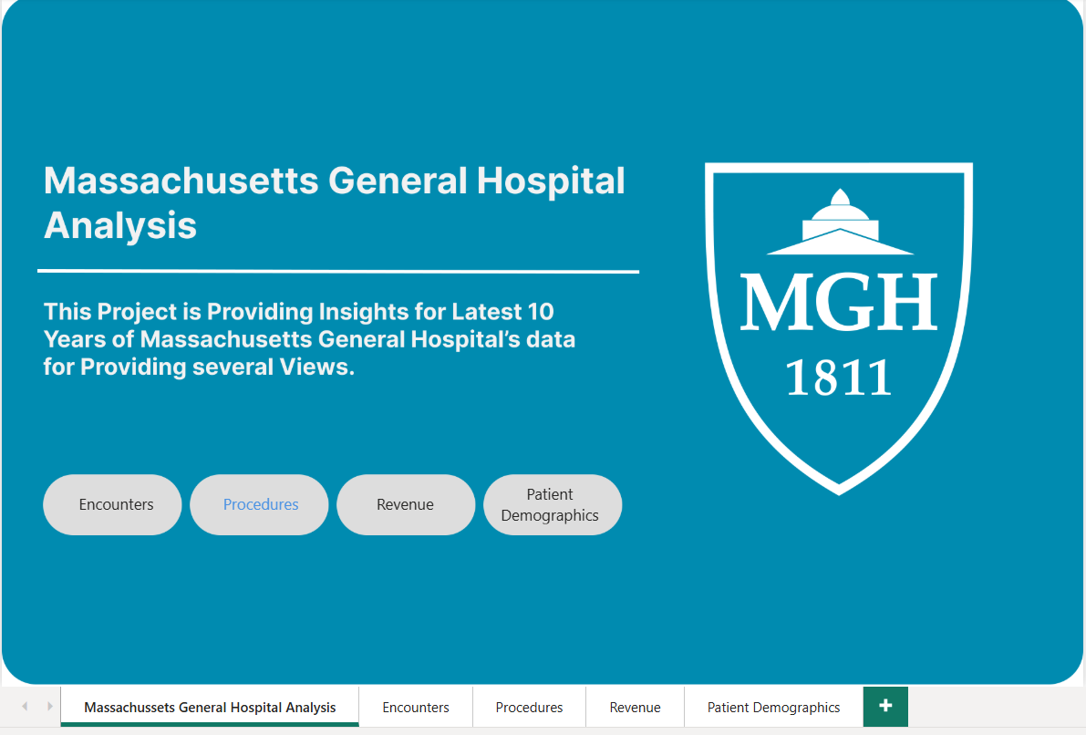
Dashboard Design & Visual Identity
1. Landing Page
Overview of key KPIs (Admissions, Revenue, Costs).

Slide 8
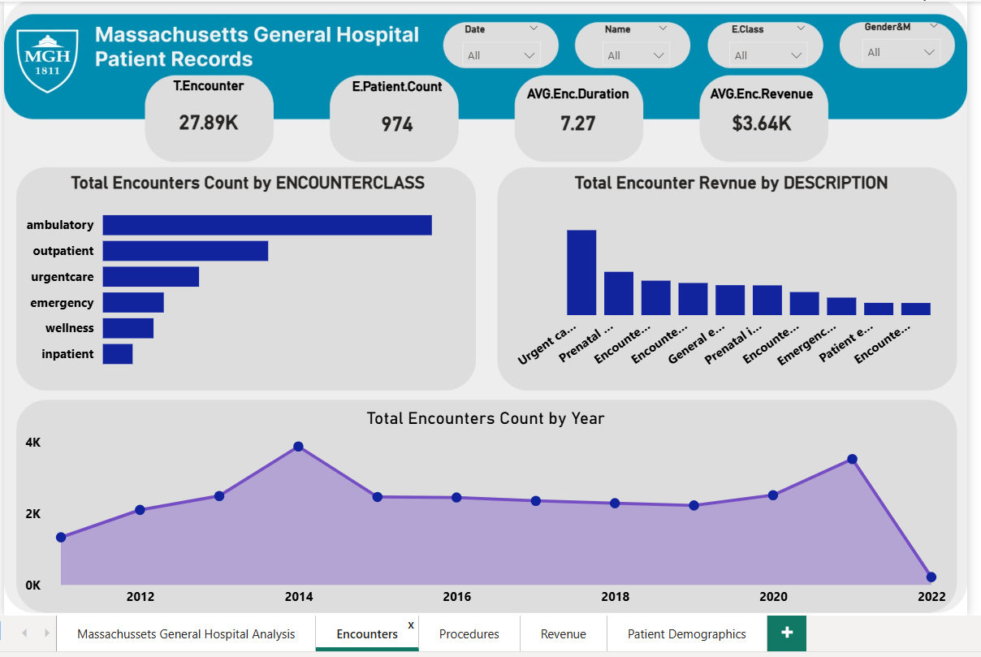
Dashboard Design & Visual Identity
2. Encounters Page
Displays encounter trends and durations.

Slide 9
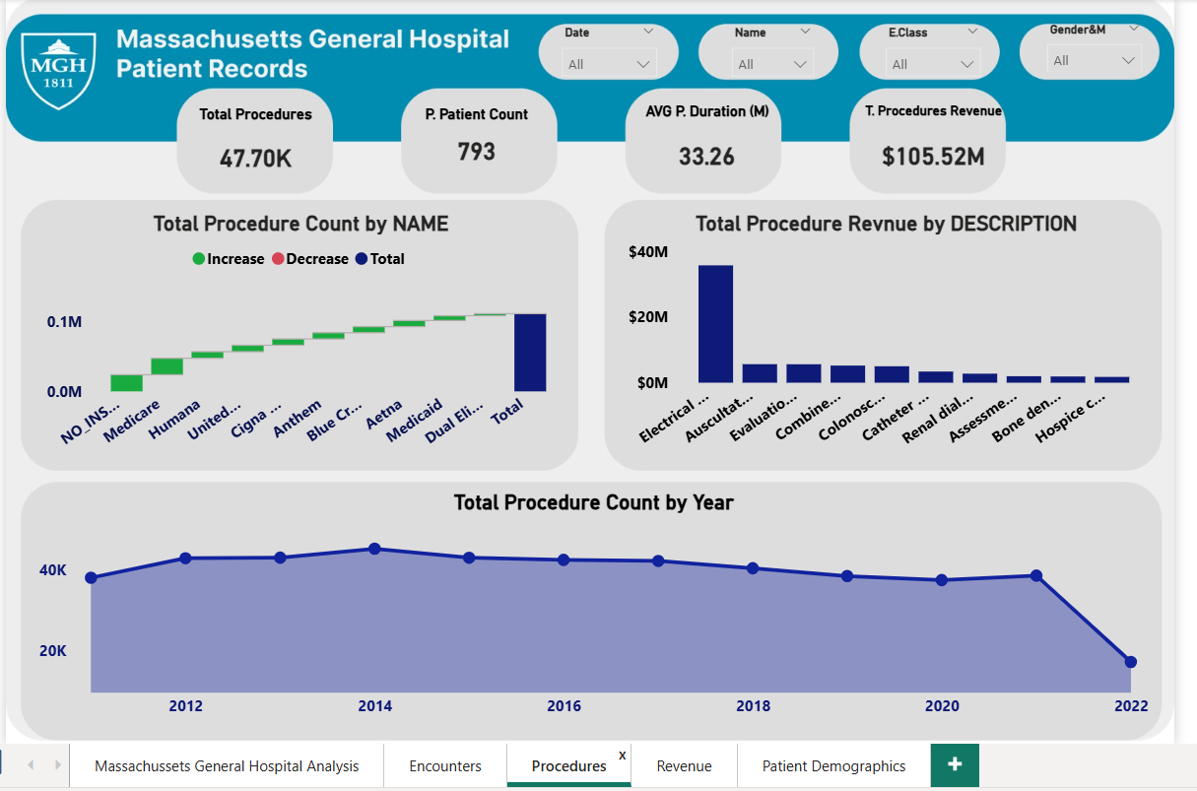
Dashboard Design & Visual Identity
3. Procedures Page
Shows frequency, costs, and outcomes of procedures.

Slide 10
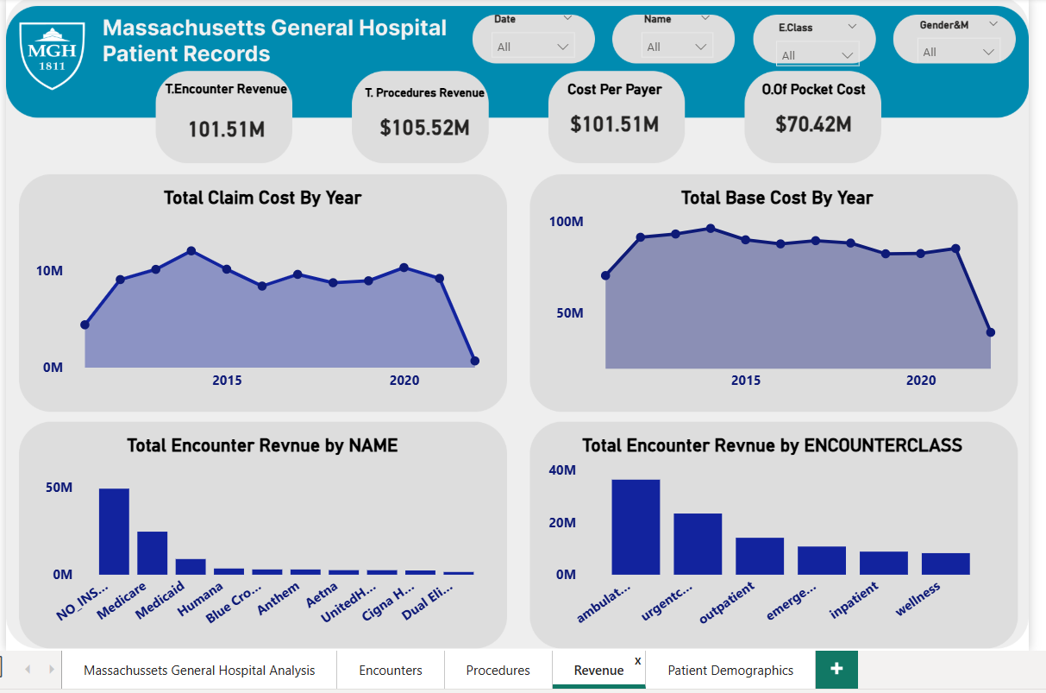
Dashboard Design & Visual Identity
4. Revenue Page
Breaks down revenue by payer and service line.

Slide 11
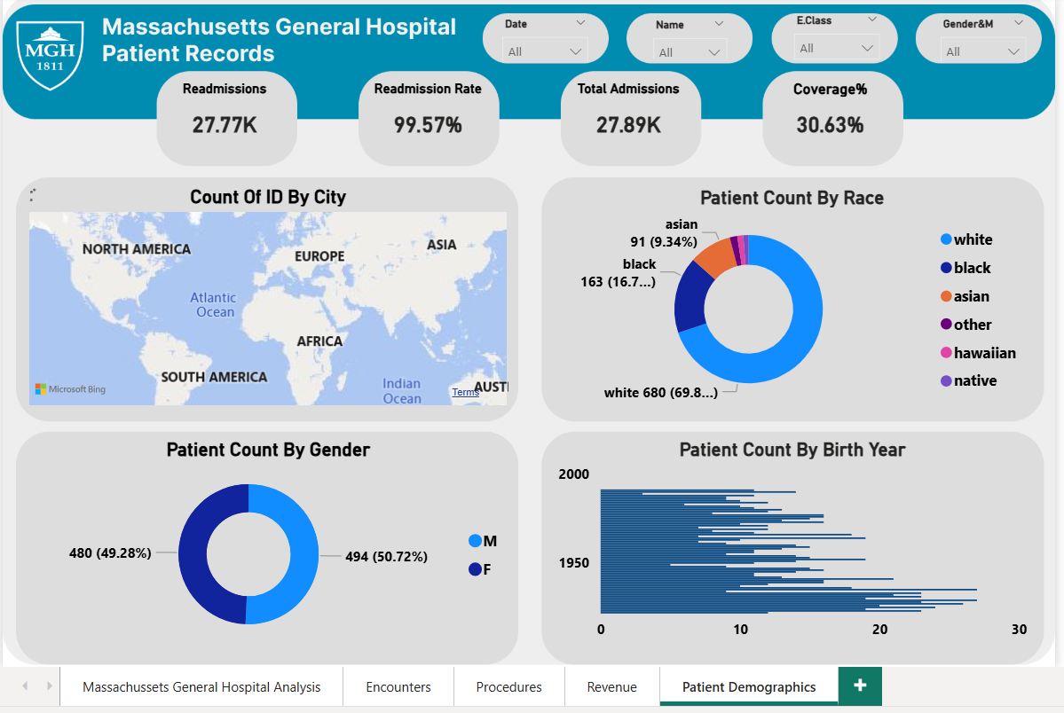
Dashboard Design & Visual Identity
5. Patients Demographics
Displays age, gender, and regional breakdowns.

Slide 12

Key Performance Indicators (KPIs)
Operational Efficiency:
Highlight successful operational metrics:
High Throughput: Total Admissions (28K) and Total Procedures (39K).
Procedure Efficiency: Avg. Procedure Duration (34.32 min).
Admissions Status: On Target ( > $ 25 K)

Slide 13

Financial Equilibrium & Cost:
Balanced Finances: Total Encounter Revenue ($101.51M) equals Total Encounter Cost ($101.51M), indicating tight financial control but almost no profit margin.
Strong Return: Avg. Procedure Revenue ($2.03K).
Key Performance Indicators (KPIs)

Slide 14

Key Performance Indicators (KPIs)
Critical Improvement Areas (KPI Evaluation Table):
Readmission Rate: 1.00 (Equal frequency), with a status of Needs Action (Target ≤ $ 0.9)
Coverage %: 0.31% (Extremely low), with a status of Critical (Target ≥ $ 10%).
Patient Financial Burden: Out-of-Pocket Cost is a heavy $70.42M, showing dependence on self-paying patients.

Slide 15

Conclusion & Recommendations
Summary of Conclusion:
Reiterate that MGH operates efficiently but must address two critical issues:
patient coverage and readmission management

Slide 16

Conclusion & Recommendations
Actionable Recommendations:
Provide concrete steps based on your critical KPIs:
Improve Follow-up Programs: To lower the high Readmission Rate.
Address Patient Coverage: Develop strategies to increase insurance utilization to mitigate the heavy patient financial burden and improve financial sustainability.

Slide 17

Roles & Responsibilities
Aya Farid – DAX measure creation and KPI calculations.
Sara Mohamed – Data modeling, dashboard integration, report coordination. Noha Yaseen – Visualization design and theme formatting. Alshaymaa Mohamed – Documentation, editing, and presentation design.

Slide 18


